Slide 1
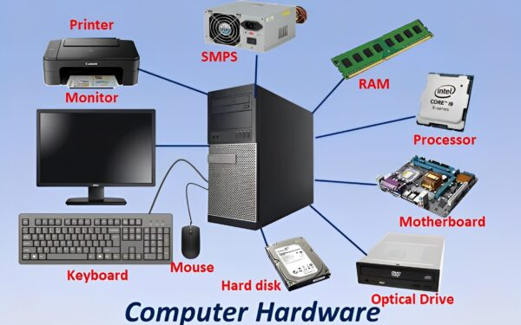
Chapter 2: Introduction to Computer Hardware

Slide 2
What is Computer Hardware?
Every physical components of a computer system
Includes input, output, processing, and storage devices
Tangible (touchable ) and visible parts

Slide 3
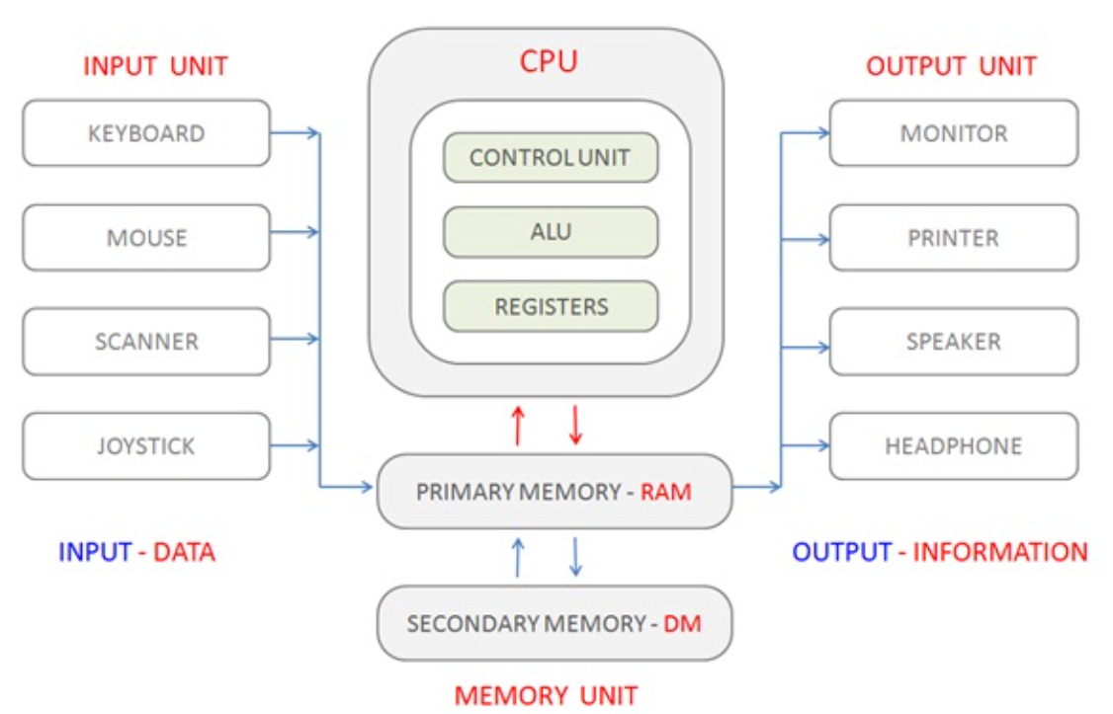
Overview of computer sustem

Slide 4
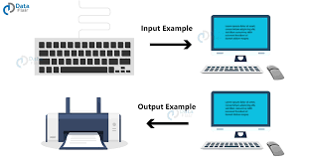
Input Devices - Overview
Used to enter data into computer
Can be manual or automatic
Examples include keyboard, mouse, scanner,etc

Slide 5
Keyboard
Used to type text and commands.
Contains letters, numbers, and special keys.
5 sections: Typing, Function, Control, Navigation, Numeric keypad.
Commonly QWERTY layout.
Most used input device.

Slide 6
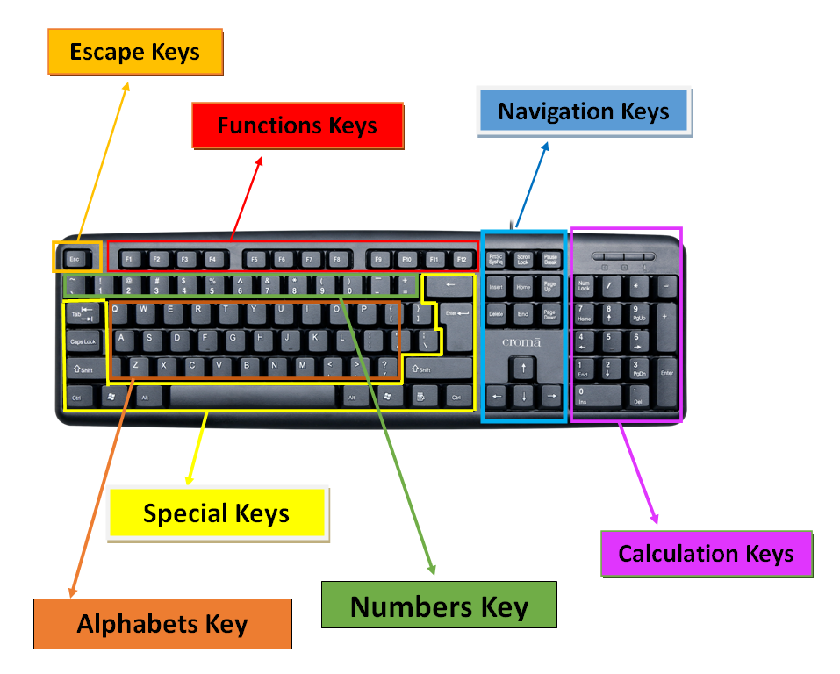

Slide 7
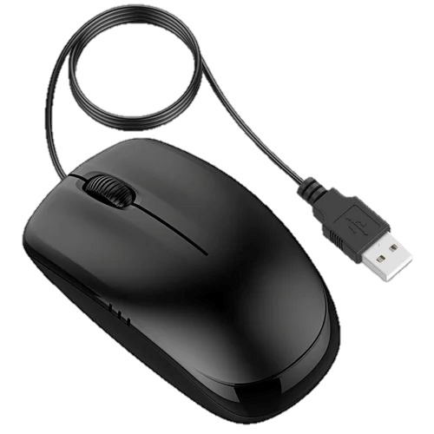
Mouse
Used to control pointer(cursor) on screen.
Has left/right buttons and scroll wheel.
Types:
Optical, Mechanical, Wireless.
Helps in selecting, dragging, opening files.
Often used with GUI systems.

Slide 8
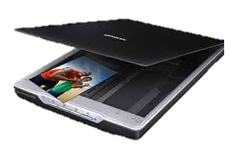
Scanner
Converts physical documents into digital format.
Flatbed scanners are most common.
Used for photos, texts, drawings.
Sends scanned image to computer.
High resolution(size) for clear output.

Slide 9

Touchpad
Flat, touch-sensitive surface.
Commonly found on laptops.
Moves cursor with finger movement.
Has click buttons or tap feature.
Alternative to external mouse.

Slide 10
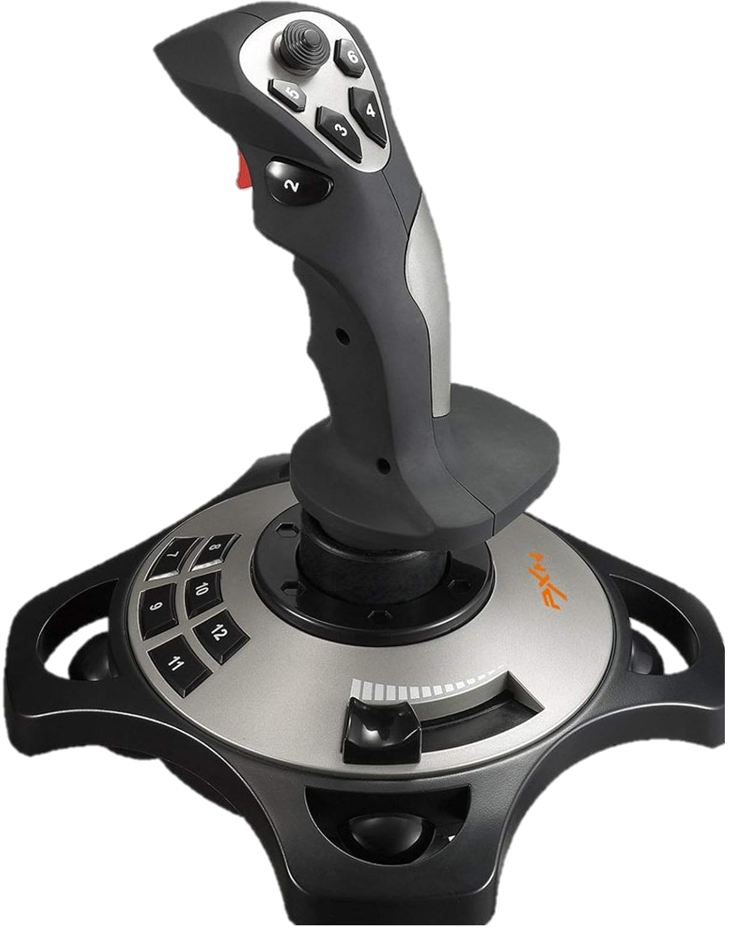
Joystick
Input device for gaming or simulation.
Moves in multiple directions.Sends signals based on movement.
Used in aircraft simulators too.
Has buttons for additional control.

Slide 11
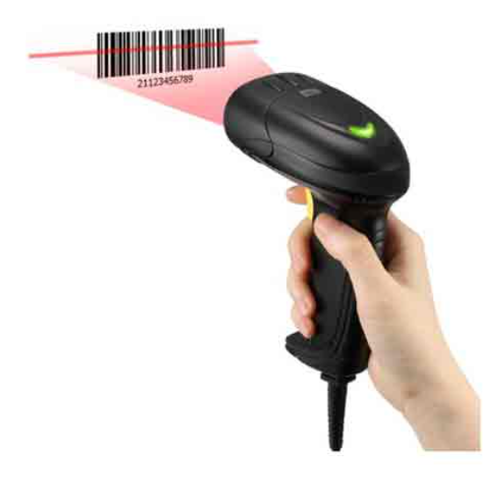
Barcode Reader
Scans black & white barcodes.
Converts barcode into digital data.
Used in shops and inventory systems.
Types: Pen-type, Laser, CCD.
Fast and accurate input method

Slide 12
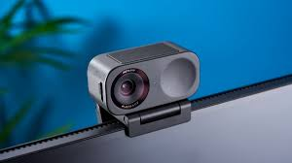
Webcam
Captures video/images in real-time.
Used for video calls, streaming.
Connects via USB or built-in.
Records or transmits to computer.
Needs light for clear image.

Slide 13
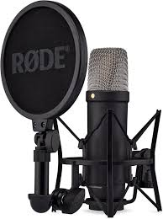
Microphone
Captures audio input.
Used in voice recording and communication.
Converts sound waves into digital signal.
Built-in or external types.
Used in voice assistants, games.

Slide 14

Converts drawings to digital format.
Used by designers and engineers.
Stylus is used to draw on pad.
High precision and control.
Common in CAD applications.

Slide 15
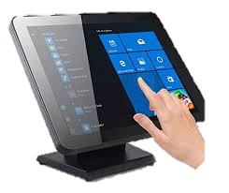
Touch Screen
Detects touch input from finger or pen.
Acts as both input and output device.
Used in phones, ATMs, kiosks.
Replaces keyboard and mouse.
Easy and interactive use.

Slide 16
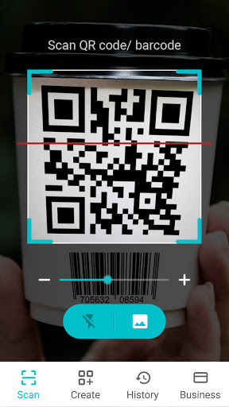
QR Scanner
Scans QR codes to read data.
Faster than barcode reader.
Used in payments, URLs, apps.
Found in smartphones or separate devices.
Secure and holds more data than barcodes.

Slide 17
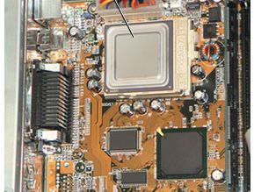
Processing Unit
English: Processing is the operation where the computer takes the input data and instructions, performs calculations or logical operations using the CPU (which includes the ALU, CU, and registers), and converts them into useful output.
Nepali: प्रोसेसिङ भनेको कम्प्युटरले इनपुट डाटा र निर्देशनहरू लिएर, CPU (ALU, CU र रजिष्टर) को सहायताले गणना वा तार्किक प्रक्रिया गरी तिनीहरूलाई उपयोगी आउटपुटमा परिवर्तन गर्ने प्रक्रिया हो।

Slide 18
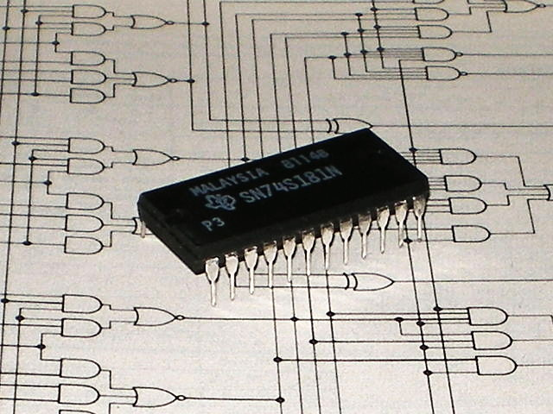
ALU
Performs arithmetic operations (add, subtract, etc.).
Handles logical comparisons (>, <, ==).
Core part of CPU.
Works with binary data.
Fast and efficient calculation.

Slide 19
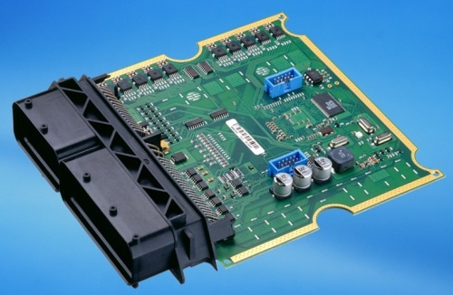
CU
Directs all computer operations.
Controls data flow between units.
Decodes instructions from programs.
Coordinates CPU activities.
Acts like the "manager" of CPU.

Slide 20
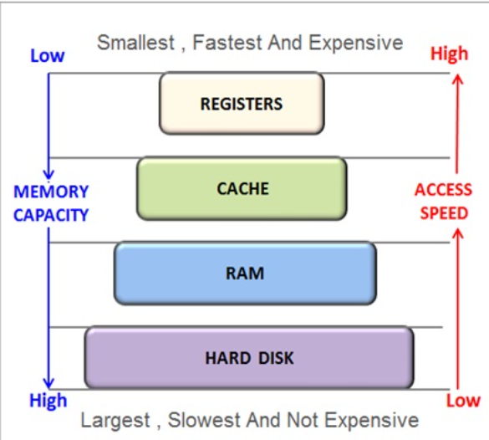
Register
CPU registers are small, high-speed memory locations inside the Central Processing Unit (CPU) used to store data and instructions that are needed for immediate use.
Very small memory inside CPU.
Stores data, instructions temporarily.
Very fast read/write access.
Examples:
Accumulator,
Instruction Register.
Helps CPU execute tasks quickly.

Slide 21
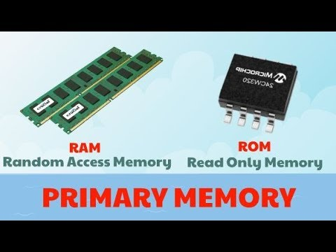
Primary Memory
Stores data temporarily for quick access
Includes RAM, ROM, Cache

Slide 22
RAM vs ROM
RAM: Volatile, fast, temporary
ROM: Non-volatile, permanent
ROM is created at the time of manufacturing
RAM is used while working; ROM stores firmware
RAM | ROM
Temporary memory | Permanent memory
Data is lost when power is off | Data stays even after power off
Read and write both possible | Only read is allowed
Stores data currently in use | Stores firmware/instructions
Faster and supports multitasking | Slower and fixed content

Slide 23
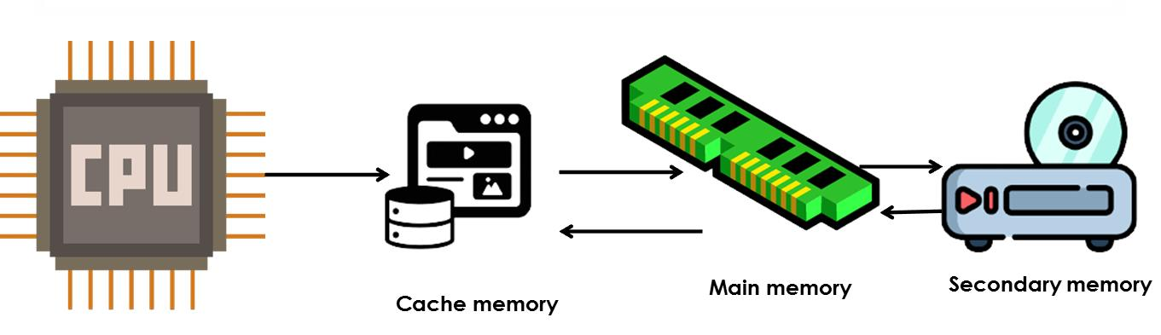
Cache Memory
Small, fast memory near CPU
Stores frequently used data for quick access

Slide 24
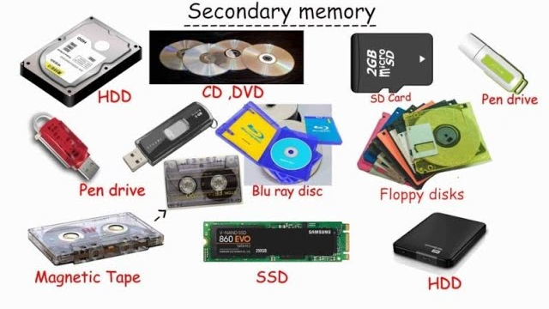
Secondary Memory
Stores data permanently
Includes magnetic, optical, and flash memory

Slide 25
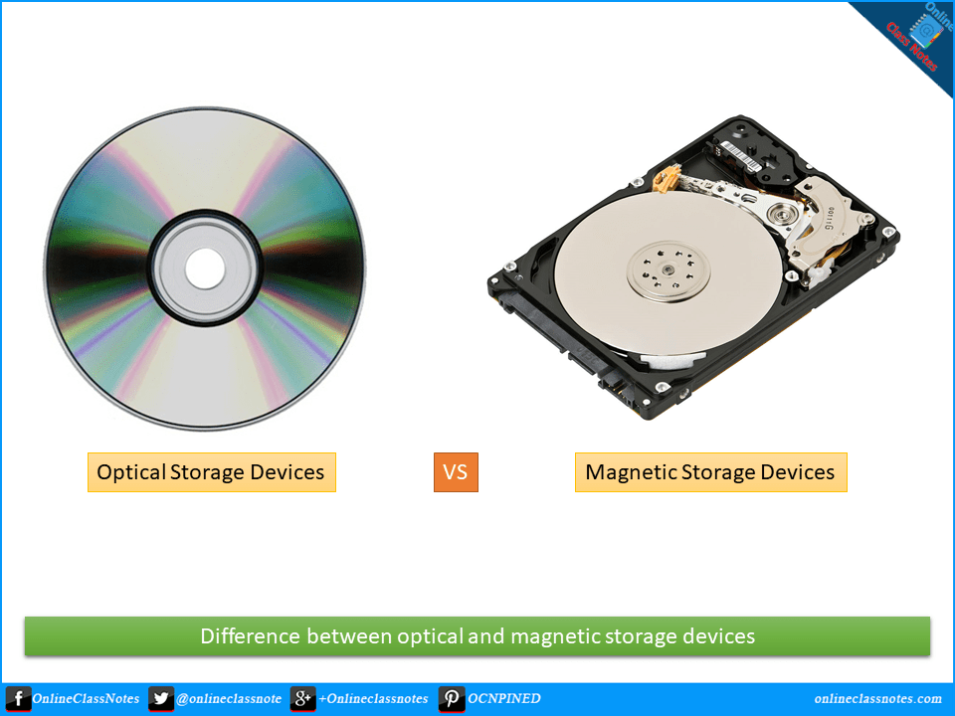
Magnetic & Optical Storage
Magnetic: Hard disk, magnetic tape
Optical: CD-ROM, CD-RW, DVD-ROM

Slide 26
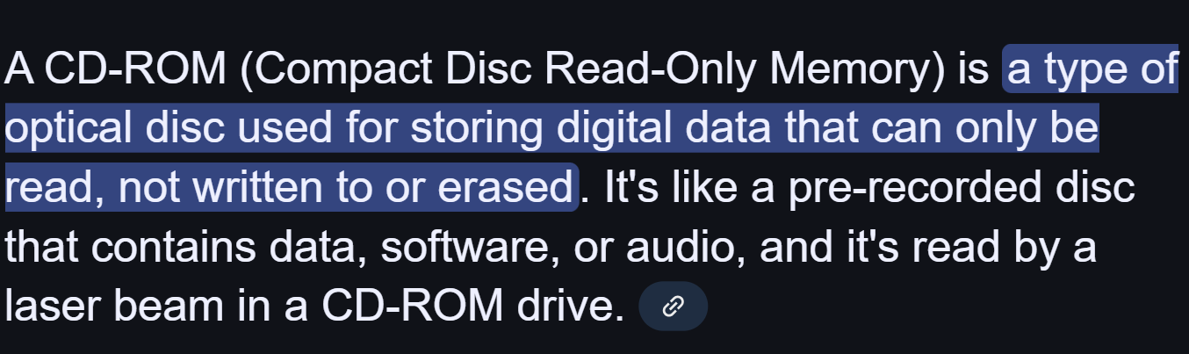
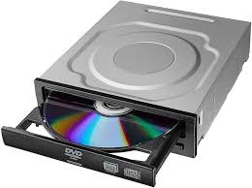
Cd rom

Slide 27
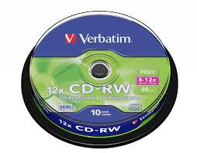
Cd - rw
a blank compact disc that can be recorded, erased, and rerecorded many times.

Slide 28
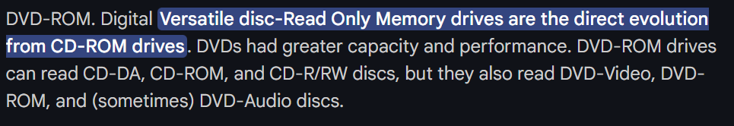
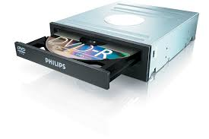
Dvd rom

Slide 29
magnetic and optical storage devices difference
Magnetic Storage | Optical Storage
Uses magnetic fields to store data | Uses laser technology to read/write data
Examples: Hard Disk, Magnetic Tape | Examples: CD, DVD, Blu-ray
Faster read/write speed | Slower compared to magnetic
Allows multiple rewrites | Limited rewrites (except RW types)
Susceptible to magnetic damage | Not affected by magnetic fields

Slide 30
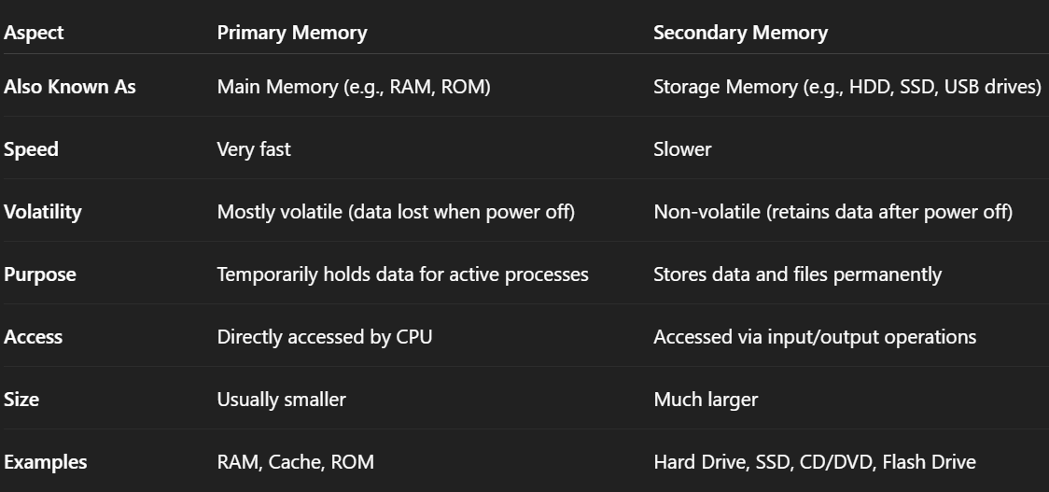
Primary vs Secondary Memory
Primary: Faster, temporary
Secondary: Slower, permanent
Used together for better performance

Slide 31
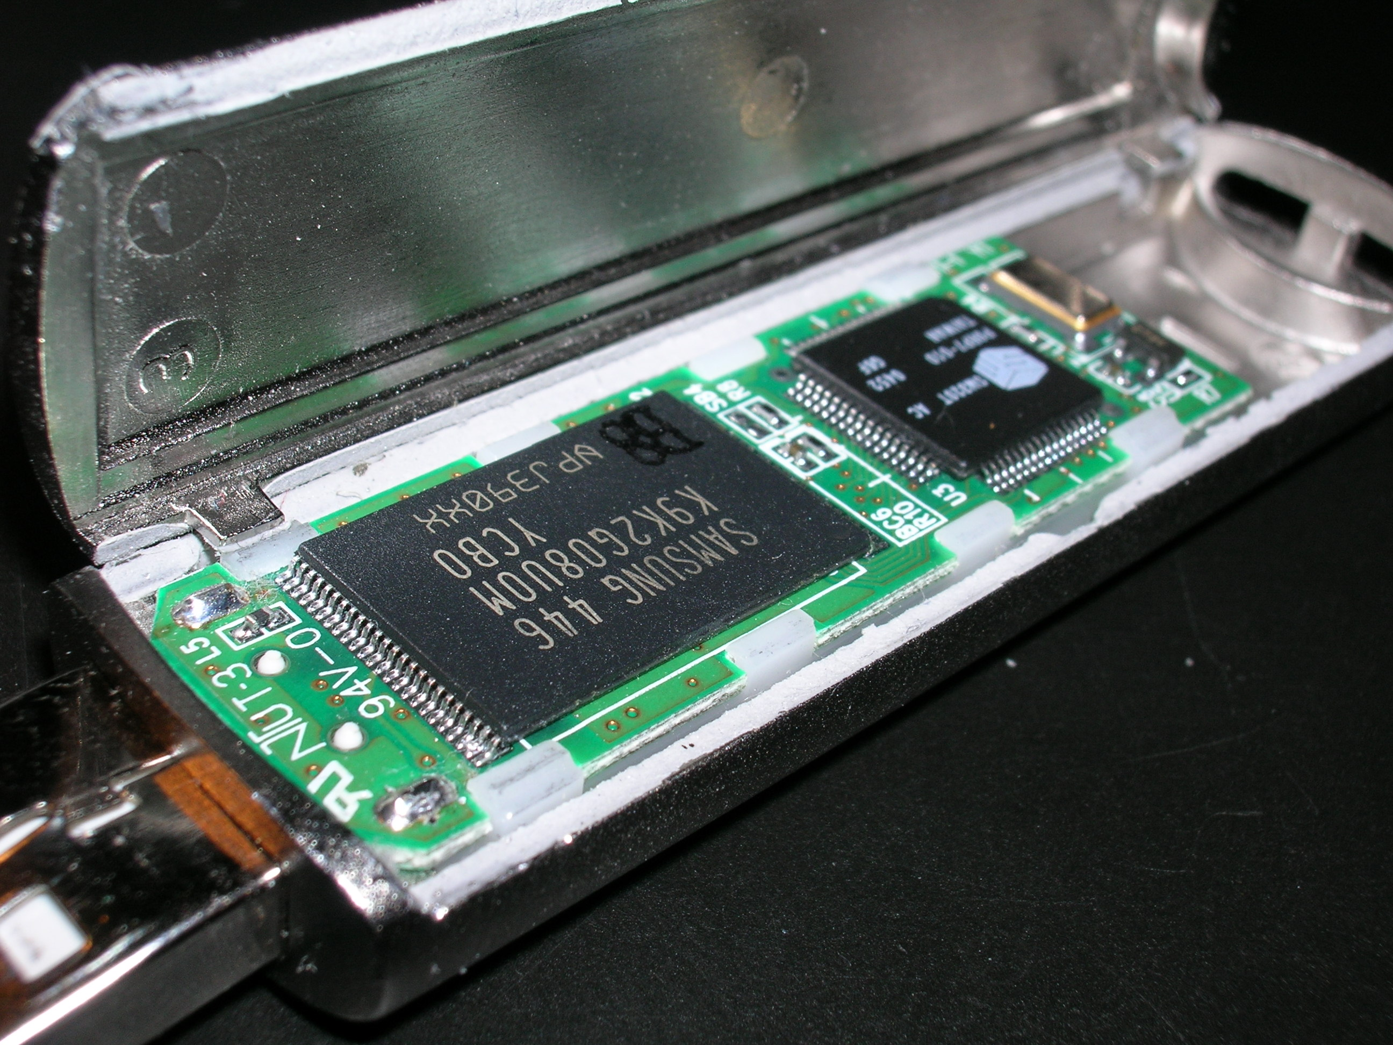
Flash Memory
Used in SSD, Pendrive, Memory Card
Fast and portable storage
This much for today

Slide 32
Units of Measurement
_{Unit} | _{Symbol} | _{Value (in Bytes)} | _{Description}
_{Bit} | _{b} | _{1/8 byte} | _{Smallest data unit (0 or 1)}
_{Byte} | _{B} | ₁ | _{8 bits}
_{Kilobyte} | _{KB} | _{1,024 bytes} | _{≈ 1 thousand bytes}
_{Megabyte} | _{MB} | _{1,024 KB = 1,048,576 bytes} | _{≈ 1 million bytes}
_{Gigabyte} | _{GB} | _{1,024 MB = 1,073,741,824 bytes} | _{≈ 1 billion bytes}
_{Terabyte} | _{TB} | _{1,024 GB} | _{≈ 1 trillion bytes}
_{Petabyte} | _{PB} | _{1,024 TB} | _{≈ 1,000 trillion bytes}
_{Exabyte} | _{EB} | _{1,024 PB} | _{Massive storage unit}
_{Zettabyte} | _{ZB} | _{1,024 EB} | _{Rarely used}
_{Yottabyte} | _{YB} | _{1,024 ZB} | _{Extremely large unit}

Slide 33
Softcopy Output Devices
Output Devices
Monitor: CRT, LCD, LED
Speaker: Outputs sound
Projector: Displays on large screen

Slide 34
CRT monitor
Here are 5 key points about CRT monitors:
1. Cathode Ray Tube: CRT stands for Cathode Ray Tube, which uses electron beams to display images on a phosphorescent screen.
2. Bulky Design: CRT monitors are large and heavy due to the vacuum tube inside.
3. High Power Consumption: They consume more electricity compared to modern LCD/LED monitors.
4. Good Color & Refresh Rate: CRTs offer excellent color accuracy and fast refresh rates, useful for gaming or graphic work in their time.
5. Obsolete Technology: Replaced by flat-screen monitors (LCD, LED), CRTs are now outdated and rarely used.

Slide 35
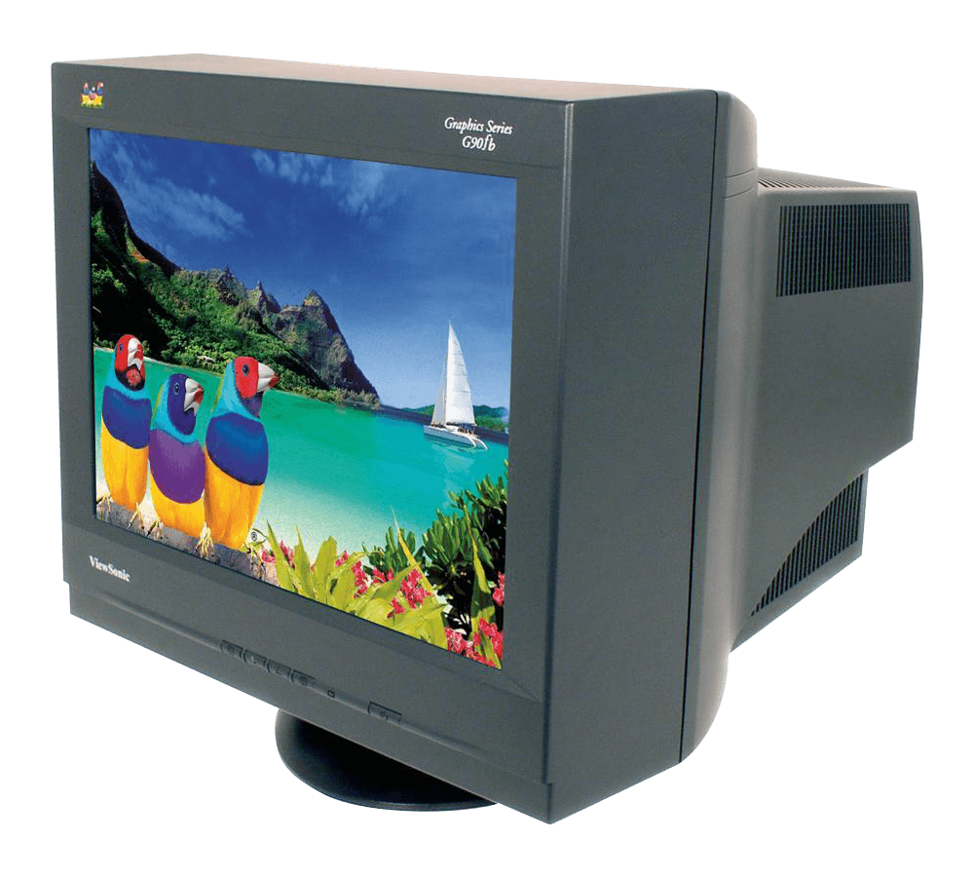

Slide 36
Lcd monitor
Uses liquid crystals and a fluorescent backlight to display images.
Slimmer and lighter than CRT monitors.
Consumes less power than CRT but more than LED.
Common in monitors, TVs, and smartphones.
Offers clear images but lower contrast than LED.

Slide 37
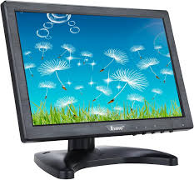

Slide 38
Led monitor
Uses LEDs for backlighting instead of fluorescent lamps.
Thinner and lighter than LCDs.
More energy-efficient.
Offers better brightness and contrast.
Longer lifespan and eco-friendly.

Slide 39
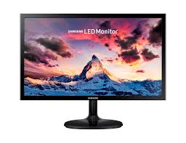

Slide 40
speaker
Output device that produces sound.
Converts electrical signals into audio.
Can be internal or external to a computer.
Used for music, videos, alerts, and communication.
Comes in various types: wired, wireless, Bluetooth.

Slide 41
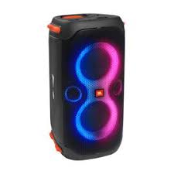
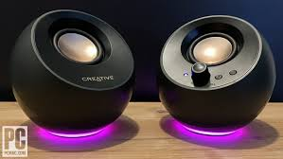
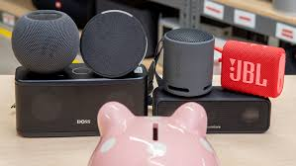
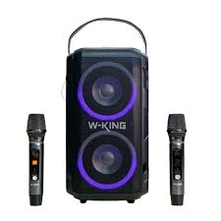

Slide 42
projector
Displays Visuals: Projects images or videos onto a screen or wall.
Used in Presentations: Common in classrooms, offices, and meetings.
Types: Includes DLP, LCD, and LED projectors.
Input Sources: Connects to laptops, USBs, or HDMI devices.
Portable Options: Some are compact and battery-powered for mobility.

Slide 43
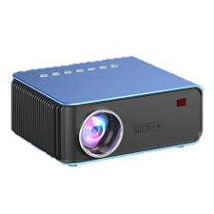
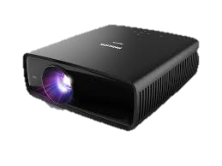

Slide 44
Hardcopy Output Devices
Printer: Impact (dot matrix), Non-impact (inkjet, laser)
Creates physical output like paper

Slide 45
Thank you for now

Slide 46
Motherboard
Main circuit board of computer
Holds CPU, memory, ports, and slots
Examples: ATX, Micro-ATX

